Slide 1

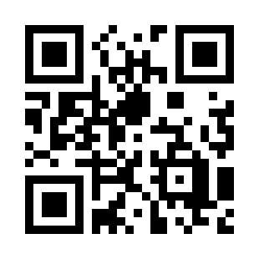
Software Design Principles Quiz
https://bit.ly/3L1n2Dl

